Slide 1
Module 2:What are the Learning styles in Differentiated Instruction?

Slide 2
Aims & Objectives
The overall aim of Module 2 is to provide you with insight into the theory behind the various learning styles and multiple intelligences and how you may practically implement these theories when planning more learner-centred lessons. Module 2 aims to provide concrete reasoning as to why learner centred lessons are particularly relevant today.
images can be changed

Slide 3
Learning outcomes
Upon completing this module, learners will be able to:
Understand what the theory of multiple intelligence is and the various components within it
Recognise what the different learning styles are and why they are useful to consider in education
Comprehend that “one size” does not fit all when it comes to education
Identify the factors that influence the constantly changing classroom

Slide 4
Keywords
Learning styles
Theory of multiple intelligences
Differentiated learning
Differentatied instruction
Education
Learner centred design

Slide 5
Table of contents
UNIT 1 WHAT ARE THE LEARNING STYLES?
2.1. Introduction
2.2. The learning Styles
2.3. The learning styles controversy
2.4. Learning style Assessment: 20 Questions
UNIT 2 ONE SIZE DOESN’T FIT ALL...
2.1. Background
2.2. What is differentiated instruction
2.3. Why does differentiated instruction matter
2.4. How does differentiated instruction better serve students
2.5. Extra reading Activity
2.6. Why now
UNIT 3 THE THEORY OF MULTIPLE INTELLIGENCES
3.1. Introduction
3.2.Time for self reflection
UNIT 4 THE FACTORS INFLUENCING CHANGE IN THE CLASSROOM
4.1. Background
4.2. Time for self reflection

Slide 6
2.1 WHAT ARE THE LEARNING STYLES?
“Everyone is a genius…but if you judge a fish by it’s ability to climb up a tree, it will live it’s whole life believing it is stupid”
-Albert Einstein

Slide 7
What are the learning styles? 2.1 Introduction:
Learning style refers to students’ preferred learning approaches for all learning situations while teaching styles refer to the lecturers’ behaviour, beliefs and selected instructional methods used to present lessons to students. (1) Currently, there are many researches that are conducted on the concepts of students’ learning style and educators’ teaching style.
In addition, students’ learning styles reflect genetic coding, personality development, and environmental adaptations (2). Research shows that students gain more knowledge, retain more information and perform better when the teachers’ teaching styles match with the students’ learning styles. (2)
.eric.ed.gov/fulltext/EJ1238274.pdf
L. Mei Ph’ng, "Teaching Styles, Learning Styles and the ESP Classroom," MATEC Web Conf., vol. 150, pp. 5082, 2018
Chetty, Nithya & Handayani, Lina & Sahabudin, Noor & Ali, Zuraina & Hamzah, Norhasyimah & Kasim, Shahreen. (2019). Learning styles and teaching styles determine students’ academic performances. International Journal of Evaluation and Research in Education (IJERE). 8. 610.10.11591/ijere.v8i4.20345. https://files.eric.ed.gov/fulltext/EJ1238274.pdf

Slide 8
What are the learning styles?
2.1 The learning styles:
While these are not hard scientific categories, they remain to serve as helpful guidelines. Research suggests there are various numbers of learning styles, but below lists those that are most well recognized and act as useful tools in tailoring lessons for learners (1):
1. Visual (spatial) learners:
These people prefer it when information is visually presented. Rather than detailed written or spoken information, such students respond better to charts, graphs, pictures and photographs. Visual aids, such as projectors and information that is organized visually is useful.
2. Auditory learners:
Auditory learners prefer processing information through listening and speaking. When reading, it often helps them to do it aloud. Some ideas to improve their learning experience include: Music (which may help by providing an emotional connection), Rhymes spoken out loud and Audiobooks when appropriate.
(1) https://www.viewsonic.com/library/education/the-8-learning-styles/

Slide 9
2.1 The learning styles:
3. Tactile learners:
This type of learners learn best by using their hands. They prefer touching things to learn about them. They often underline what they read, take notes during listening, and keep their hands busy in other ways.
4. Verbal Learners:
These students enjoy making use of the language itself. Like aural learners, verbal ones enjoy rhymes and wordplay. They would typically respond well to activities that encourage group discussions, assignments on class presentations , or role-plays with interesting scenarios.
5. Logical Learners:
Logical learners look for patterns and trends in what they learn. They search for the connections, and the reasons and results. Teachers can best motivate them by using lessons that introduce questions that demand interpretation and inference, present material requiring problem-solving abilities or encourage them to reach conclusions based on facts and reasoning

Slide 10
2.1 The learning styles:
6. Individual (solo) learners:
These students like their privacy and are independent, and introspective. Learners with individual preference often can focus on the issues well, be aware of their own thinking, and analyze in a different way what they think and feel. Activities that focus on individual learning and problem-solving would be useful.
7. Group (social) learners:
These individuals are good at communicating well with people, both verbally and non-verbally. They prefer mentoring and counselling others. Group activities that incorporate role-playing or that encourage students to ask others question and share stories would be most appropriate here.

Slide 11
What are the learning styles? 2.1 Learning styles controversey?
The concept and existence of learning styles has been fraught with controversy, and recent studies have thrown their existence into doubt. (1) Yet, many students still hold to the conventional wisdom that learning styles are legitimate, and may adapt their outside of class study strategies to match these learning styles.
To put it simply, everyone is different. It is important for educators to understand the differences in their students’ learning styles, so that they can implement best practice strategies into their daily teaching activities, curriculum and assessments.
(1) https://www.thoughtco.com/learning-styles-controversy-31153

Slide 12
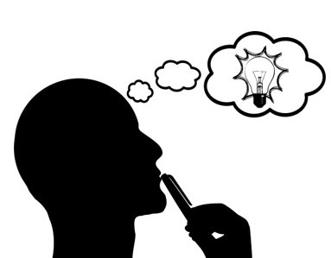
Time for an Assessment
2.1 What's Your Learning Style? 20 Questions
Why not give your VET students this test to check their learning style. This could be a good starting point for implementing differentiated lessons on this basis!

Slide 13
2.2 One size doesn’t fit all....
“As with clothing, so with lessons: One Size does not fit all….”

Slide 14
One size doesn’t fit all... 2.2 Background
Education has traditionally been approached using a “one size fits all” model, wherein students are subjected to the same teaching styles and evaluation methods irrespective of their ability or interest. Given that different students have different learning styles, have different strengths and weaknesses, and face varying responsibilities within their personal lives, does it make sense to throw all students onto the same “conveyor belt” of education and expect the same outcomes? The answer, simply, is no.
Curriculums should be differentiated to suit the individual needs of each unique student. Only then can learners receive the best possible education and be prepared for future success.
Therein lies the need for differentiated instruction/learning!

Slide 15
One size doesn’t fit all… 2.2 What is differentiated Instruction?
According to Carol Ann Tomlinson (a renowned expert in the field of differentiated instruction), “At its most basic level, differentiation consists of the efforts of teachers to respond to variance among learners in the classroom. Whenever a teacher reaches out to an individual or small group to vary his or her teaching in order to create the best learning experience possible, that teacher is differentiating instruction.” (1)
(1)https://www.readingrockets.org/article/what-differentiated-instruction
Click above to listen to expert Tomlinson give insight into the differentiated instruction method!

Slide 16
One size doesn’t fit all… 2.2 Why Does Differentiated Learning Matter?
In many educational settings it is common for a student's day to largely consist of sitting at a desk, listening to a teacher/trainer lecture, and taking notes in preparation for an exam or test. However, when we take into consideration that not all students learn effectively with this method, it becomes clear that what we really need in more classrooms across the EU is student centered or differentiated learning.
Research finds that students immersed in student centered classrooms are more engaged and achieve more than students in traditional classrooms. (1) In other words, a differentiated learning approach is more likely to reach students than the traditional one-size-fits-all lecture.
(1) https://www.whitbyschool.org/passionforlearning/differentiated-learning-why-one-size-fits-all-doesnt-work-in-education#:~:text=Research%20finds%20that%20students%20immersed,size%2Dfits%2Dall%20lecture.

Slide 17
One size doesn’t fit all… 2.2 Extra Reading Activity
Step 1: Take 15 minutes to quicky scan through the below publication
STUDENT–CENTRED LEARNING: WHAT DOES IT MEAN FOR STUDENTS AND LECTURERS?
Step 2: Outline the main learning points of the effectiveness and critiques of student–centred learning

Slide 18
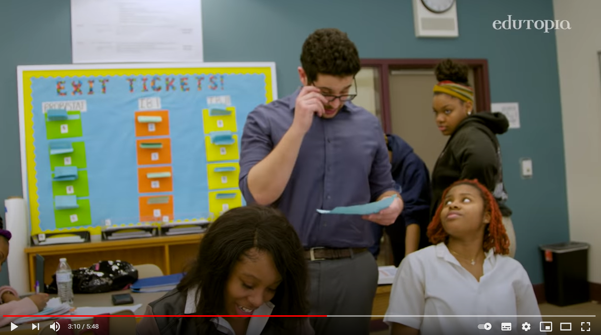
One size doesn’t fit all… 2.2 How does differentiated learning better serve students?
Differentiated learning refers to a style of teaching that allows students to work more independently in the classroom and construct lessons based on their own learning styles. (1) In other words, this style of teaching gives students the power to tailor their learning experiences in a way that best suits their unique needs.
Let’s think about primary school math, for example. Explaining how simple addition works or even demonstrating it on the whiteboard may only resonate with certain students. In reality, social learners may learn best by working in groups that can solve problems together. A set of blocks could help physical learners visualize a mathematical concept. And solitary learners could learn best by taking practice worksheets into a quiet corner.
(1)https://www.whitbyschool.org/passionforlearning/differentiated-learning-why-one-size-fits-all-doesnt-work-in-education#:~:text=Unfortunately%20the%20%22one%20size%20fits,be%20prepared%20for%20future%20success.
Click above to see how a differentiated instruction approach benefits learners in practice!

Slide 19
One size doesn’t fit all… 2.2 Why now?
Students struggle to adapt
Disadvantages Students
Educators CAN adapt
Since the pandemic struck in March 2020, an estimated 1.37 billion students are out of the classroom and are learning remotely. With VET colleges and HEI’s switching between in-person and online learning, some students struggle to adapt their learning styles and stay on top of their work.
A big worry for many was that when educational institutions went online, many students who were already disadvantaged returned to environments with relatively fewer resources to support learning, thus putting them at a further disadvantage.
The pandemic has caused major disruption across many sectors and industries, arguably education has been one of the hardest hit. But it highlighted how Institutions and it’s educators were able to adapt their teaching activities and delivery in order to meet the needs of the students, thus paving the way for further innovation and change in education.

Slide 20
2.3 The Theory of Multiple Intelligences

Slide 21
The Theory of Multiple Intelligences 2.3 Introduction
The Theory of Multiple Intelligences suggested by Gardner in the early 1980s as an alternative way to traditional classroom designs that as a need for the variety of ways people learn and understand. Gardner (1983) suggested that learners do not have a single intelligence, but a range of intelligences. His assumption is that all people have these intelligences but in each person one of them is more pronounced. (1)
https://files.eric.ed.gov/fulltext/EJ1170867.pdf
Gardner (2013) asserts that regardless of which subject you teach—“the arts, the sciences, history, or math”—you should present learning materials in multiple ways. Gardner goes on to point out that anything you are deeply familiar with “you can describe and convey … in several ways. We teachers discover that sometimes our own mastery of a topic is tenuous, when a student asks us to convey the knowledge in another way and we are stumped.” Thus, conveying information in multiple ways not only helps students learn the material, it also helps educators increase and reinforce our mastery of the content. (2)
(2) https://www.niu.edu/citl/resources/guides/instructional-guide/gardners-theory-of-multiple-intelligences.shtml

Slide 22
Time for Self-Reflection
2.3 Click video icon and find out what the 8 intelligences are:
Can you apply these Multiple Intelligences in your classroom? If yes, which strategies are the most applicable for your VET students?

Slide 23
The Theory of Multiple Intelligences:
2.3 Educational benefits
All students develop different types of intelligence. This means that each student has their own intelligence superiorities and weaknesses. Called a learning style, these intelligence domains determine how easily or difficultly a student can learn through a specific teaching method.
There can be more than one learning style present in a classroom. To balance learning styles and subject matter, a teacher should show students how to understand a subject which addresses one of their weak intelligence domains by applying their most developed intelligence domain. For instance, a student who has highly-developed musical intelligence can be asked to learn about a war and what happened during that war by making up a song about it (Temur, 2007).
Moreover, students who apply their strong fields of intelligences in learning activities can learn a subject that they used to hate with joy and without pressure. As another example, mathematics is considered to be a tough subject for many students due to the abstract concepts they have to learn. However, when such concepts are explained through a learning activity that implements students’ intelligences, students will find it more interesting and more fun because it is given as something they love to do. Students can learn mathematics by drawing, dancing, blogging, and much more. A whole curriculum can be created with activities based on multiple intelligences in a way that develops different fields of intelligences for each student ; such curriculum will be more student-centered. Students will then discover the best ways by which they’re able to receive information.
Reference: https://www.onatlas.com/blog/multiple-intelligences-theory

Slide 24
Time for Additional Reading!
2.3 Click document icon and be inspired by Learning Activities that connect with Multiple Intelligences:
Can you apply any of the above Multiple Intelligences Activities in your classroom? If yes, which strategies are the most applicable for your VET students?

Slide 25
The Theory of Multiple Intelligences 2.3 Challenges
1
Not all the intelligences included in the theory can be targeted easily when preparing a learning activity.
2
The challenge is to target the maximum number of intelligences in one session to ensure the engagement of all students in a classroom.
3
Educators should also be careful that addressing a specific type of intelligence doesn’t mean ignoring other types because the aim is to reach students’ minds as well as developing all their skills.
Reference: https://www.onatlas.com/blog/multiple-intelligences-theory

Slide 26
2.4 The factors influencing change in the classroom

Slide 27
What factor influence change in the classroom?
2.4 Background
1.
Standard-based classrooms: targeted expectations set by districts, states, and nations
Multicultural diversity: continuous influx of immigrant learners with little or no communication skills or competencies in English
Student diversity: unique learning styles and different levels of multiple intelligences
New cognitive research on human learning: knowledge of the brain and how it processes memory and makes meaning
Rapid societal and technological change: political and economic revolutions that influence what and how learning takes place
2.
We have been faced with more change than ever before in education. Several decades ago, teachers came into the profession with a desire to work with learners, a knowledge base, and good intentions. Today, educators face a challenging landscape that is in constant flux. Many factors influence the constantly changing classroom:
3.
4.
5.

Slide 28
Time for Self Reflection
2.4 Can you find any of these factors in your classroom? Please share with us your examples

Slide 29
List of references and further reading
L. Mei Ph’ng, "Teaching Styles, Learning Styles and the ESP Classroom," MATEC Web Conf., vol. 150, pp. 5082, 2018
Chetty, Nithya & Handayani, Lina & Sahabudin, Noor & Ali, Zuraina & Hamzah, Norhasyimah & Kasim, Shahreen. (2019). Learning styles and teaching styles determine students’ academic performances. International Journal of Evaluation and Research in Education (IJERE). 8. 610.10.11591/ijere.v8i4.20345. Retrieved from: https://files.eric.ed.gov/fulltext/EJ1238274.pdf
View Sonic, The 8 Learning Styles, (2020), Retrieved from: https://www.viewsonic.com/library/education/the-8-learning-styles/
Deb Peterson, The Learning Styles Controversy - Arguments For and Against, Thought.Co, (2020) Retrieved from: https://www.thoughtco.com/learning-styles-controversy-31153
Carol Ann Tomlinson, What Is Differentiated Instruction? Retrieved from: https://www.readingrockets.org/article/what-differentiated-instruction
Sarah Mead, Differentiated Learning: Why "One Size Fits All" Doesn't Work In Education, Whitby, Retrieved from: https://www.whitbyschool.org/passionforlearning/differentiated-learning-why-one-size-fits-all-doesnt-work-in-education#:~:text=Research%20finds%20that%20students%20immersed,size%2Dfits%2Dall%20lecture.
Sabriye Şener, Ayten Çokçalışkan, An Investigation between Multiple Intelligences and Learning Styles, Journal of Education and Training Studies, Vol. 6, No. 2; February 2018 Retrieved from: https://files.eric.ed.gov/fulltext/EJ1170867.pdf
Northern Illinois University Center for Innovative Teaching and Learning. (2020). Howard Gardner’s theory of multiple intelligences. In Instructional guide for university faculty and teaching assistants. Retrieved from https://www.niu.edu/citl/resources/guides/instructional-guide
Rima Amacha, Ahliah School, Using the Multiple Intelligences Theory in a Classroom, (2017) Retrieved from: https://www.onatlas.com/blog/multiple-intelligences-theory

Slide 30
Thank-you for your attention

