Slide 1
MODULE 6: TOP TEACHER SKILLS FOR DIFFERENTIATED INSTRUCTION

Slide 2
LEARNING OUTCOMES
Upon completing this module, you will be able to:
Identify and give examples of at least 6 key skills for inclusive educators and differentiated instruction
Reflect on your own skills for differentiated instruction and inclusive teaching
Apply new strategies, techniques and exercises to put these skills to use and work in your differentiated, inclusive classroom.

Slide 3
AIMS & OBJECTIVES
By the end of this module, you will understand the importance of enhancing your soft skills for inclusive and innovative teaching.
You will learn how to incorporate and apply your soft skills as an essential component(s) of your differentiated teaching/training delivery.

Slide 4
Keywords
Teacher Skills
Soft Skills
Differentatied Instruction
Inclusive Teaching
Inclusive Leadership

Slide 5
Table of contents
UNIT1: Inclusive Communication Skills
UNIT2: Inclusive Leadership Skills
UNIT3: Inclusive Digital Skills
UNIT4: Empathy Skills
UNIT 5: Differentiated Assessment Skills
UNIT 6: Teaching students to apply the concept

Slide 6
MODULE INTRODUCTION
In this course, we have been learning about differentiated instruction and how educators can use it to actively plan for your students' differences so that all students regardless of their age, gender, ethnicity, sexual orientation… can learn to the best of their ability and in a safe, secure, inclusive manner.
In a differentiated classroom, educators divide their time, resources, and efforts to effectively teach students who have various backgrounds, readiness/skill levels, and interests. To effectively differentiate, educators need certain skills. We will explore some of these skills in this module. We invite you to reflect and assess your own skills levels, making note of areas where you feel you can improve as we move through the module.

Slide 7
UNIT 1: INCLUSIVE COMMUNICATION SKILLS
The idea of inclusive communication comes from an understanding that people communicate differently, and various techniques are needed to meet these different needs.
Using inclusive communication techniques in the classroom is a key part of differentiated instruction which involves providing different levels or instructional techniques for different individual students.

Slide 8
WHY ARE INCLUSIVE COMMUNICATION SKILLS IMPORTANT?
The Council of Europe has defined a set of competences that teachers should acquire in order to effectively champion diversity in the classroom. Communication and Relationships is a key focus. The CoE says, Teachers should:
Initiate and sustain positive communication with learners and colleagues from diverse backgrounds
Create open mindedness and respect in their classrooms and school community
Motivate and engage students to engage in learning individually and in cooperation with others
Deal with discrimination and conflicts to prevent marginalistion and school failure
In this section, we will explore some important communication skills need in order to be able to do these things.

Slide 9
COMMUNICATION SKILLS IN EDUCATION
Educators wear many hats every day while in the classroom: the organizer, instructor, speaker, facilitator, entertainer and sometimes dispute resolution specialist.
Educators interact not only with students/learners, but with other educators, school administration staff and depending on the level they teach sometimes parents too.
Strong interpersonal skills and communication are key for any inclusive/innovative educator.
Source

Slide 10
INTERPERSONAL COMMUNICATION SKILLS
Interpersonal skills are those which help a person communicate well.
As the name says interpersonal, it means when the communication takes place between two individuals, then the communication is said to be interpersonal.
As educators, we need to be mindful and remember that communication can take place in any form like verbally, non-verbally, through gestures, through eye moments, different postures and so on..
Source

Slide 11
Communication Skills are key when addressing learning barriers like language..
“When I came to Ireland, I didn’t speak English. I used to just answer all questions with “yes, yes, yes” but I didn’t understand anything, I just wanted to escape.”
Rodica Lunca is Roma and came to Ireland from Romania in 2001
Source 1, Source 2

Slide 12
COMMUNICATION COMPONENTS
Language is a very important component of the communication process. In a diverse classroom, not everyone speaks the same language to the same level but that does not mean that we cannot communicate.
Inclusive and innovative educators are mindful of other communication methods that can be even more powerful than words.
Let’s explore some of these..
Source

Slide 13
Did you know that language-specific words account for only 10% of communication? The communication process is actually 90% made up of non-verbal information in the forms of tone and body language.
Body language: our mannerisms and demeanour
facial expressions
gaze—looking at the other person or away from them; paying attention or not
gestures—arm and hand movements
posture—leaning forward or back; relaxed or stiff
distance from the other person—too close or too far
Tone: the way we speak
fast or slow
gentle or aggressive
with or without pauses

Slide 14
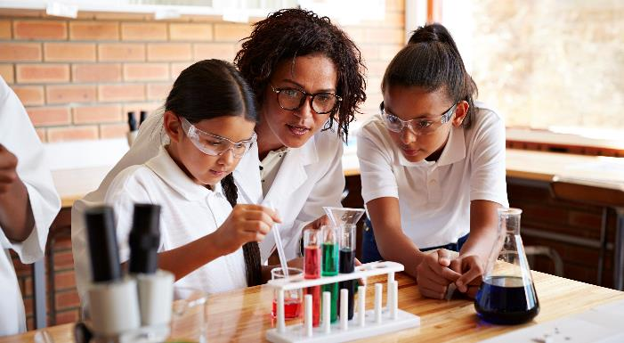
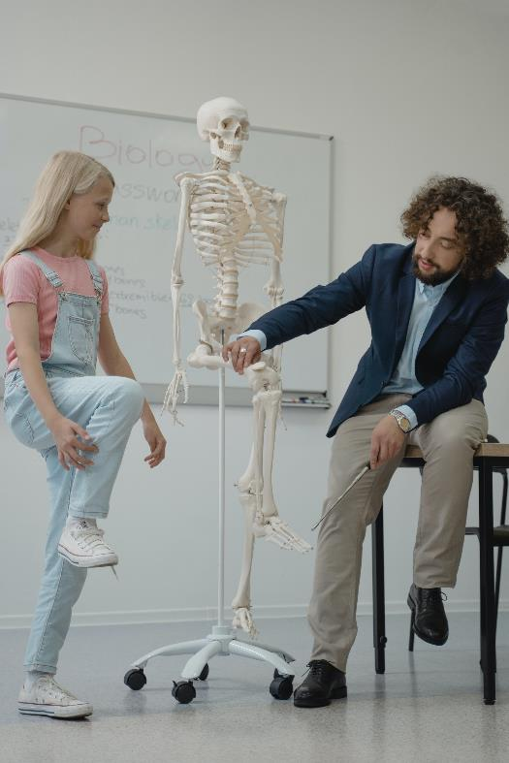
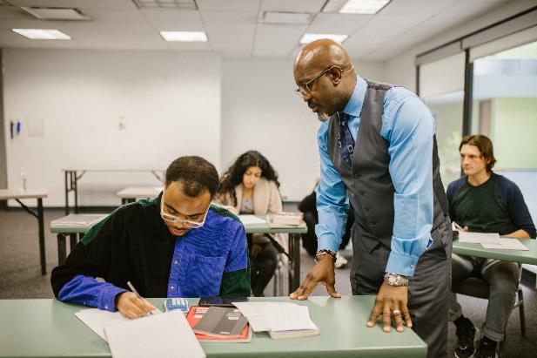
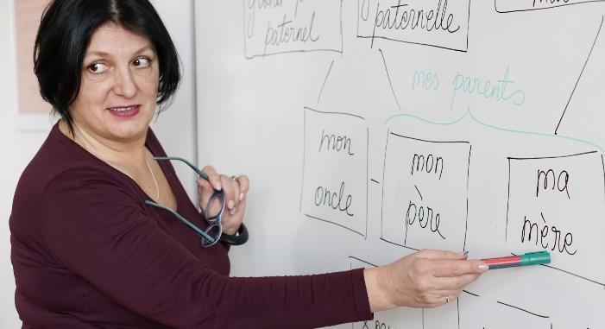
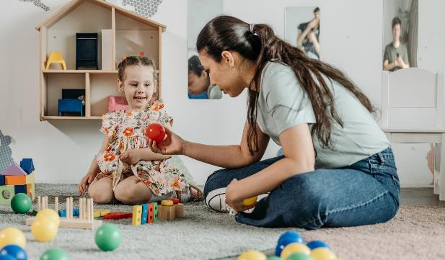
Have a look at the body language of the educators in these pictures. Make some notes on their body language. Is it open, friendly, welcoming, negative?
Time for Self-Reflection
Reflect on your own body language in the classroom, how open, welcoming, inclusive would you say it is..

Slide 15
TIPS FOR BETTER COMMUNICATION IN A DIVERSE CLASSROOM
BE MINDFUL OF HOW YOUR BODY LANGUAGE IS INTERPRETED
DIFFERENTIATE YOUR COMMUNICATION METHODS
Read information aloud that is presented visually. Give both oral and written instructions.
Suggest students record audio of your classes. It can be helpful for many students with language difficulties to listen to the words several times.
Some students with learning disabilities can misunderstand tone of voice, facial expression and gestures. Students who are learning English might also come from different cultures where a gesture has a different meaning.
Use words to reinforce your body language when you need the class to know how you feel.

Slide 16
TIPS FOR BETTER COMMUNICATION IN A DIVERSE CLASSROOM
SHOW AND TELL
UNDERSTAND POTENTIAL COMMUNICATION ISSUES
Use body language that aids in communication.
Act it out.
Demonstrate using real objects.
Use visuals and reinforce with written material whenever possible.
No two students are the same and it is crucial that in our effort to become more inclusive educators we learn all that we can about any communication difficulties students in our classroom including but not limited to speech, language and sensory processing issues. The more informed we are, the better we can accommodate these with differentiated learning

Slide 17
TIPS FOR BETTER COMMUNICATION IN A DIVERSE CLASSROOM
BE MINDFUL OF AND USE GENDER-NEUTRAL LANGUAGE
CREATE OPEN AND RESPECTFUL DIALOGUES
Using gender-neutral language and respecting student’s pronouns goes a long way in making students feel a sense of belonging. As educators, it is crucial we suppress gender oppression and learn about and integrate gender inclusive language, practices, and general knowledge into classroom settings.
Establishing ground rules for conduct and dialogue in the classroom can be extremely helpful when trying to create a space for establishing an open and respectful dialogues. Open and respectful dialogues can increase a feeling of being safe and secure in school which is necessary for students' learning and development.

Slide 18
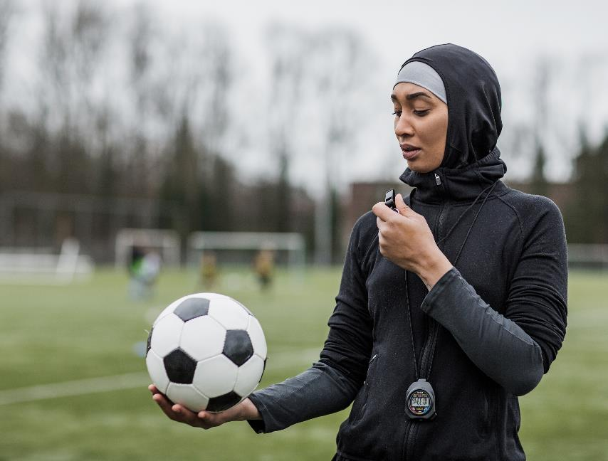
UNIT 2 LEADERSHIP SKILLS AND TRAITS
As educators, we are role models every day for the students and learners that we teach.
Our own behaviour and actions are the single most important way that we demonstrate inclusive leadership in and outside the classroom.

Slide 19
WHY ARE INCLUSIVE LEADERSHIP SKILLS IMPORTANT?
Inclusive leadership is about:
Treating students and learners fairly—that is, based on their unique characteristics, rather than on stereotypes
Personalizing individuals—that is, understanding and valuing the uniqueness of diverse others while also accepting them as members of the group
Leveraging the thinking of diverse groups for smarter ideation and decision making that reduces the risk of being blindsided

Slide 20
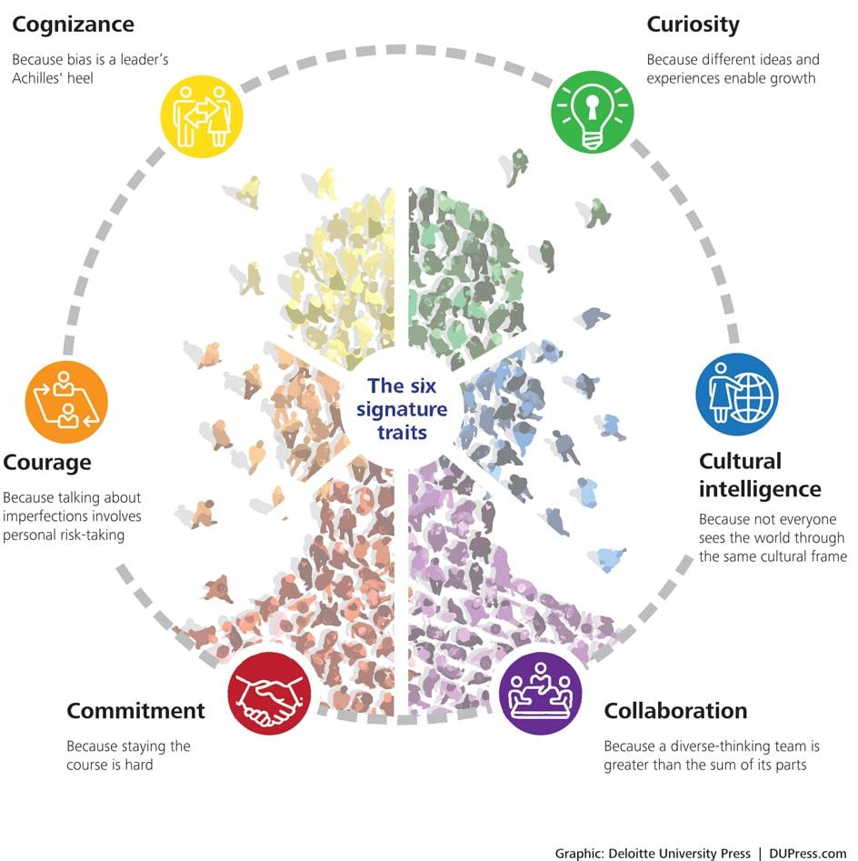
INCLUSIVE LEADERS HAVE RECOGNISABLE TRAITS.
Let’s explore each of these in the context of an inclusive and innovative classroom.
Source

Slide 21
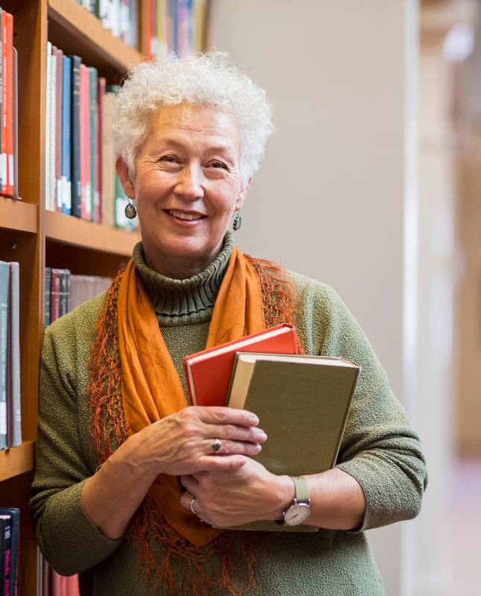
1. COMMITMENT
Highly inclusive leaders are committed to diversity and inclusion. As educators in the 21st Century, it is imperative that we embrace diversity, including differences in ethnicity, culture, socioeconomic status, disability, and sexual orientation.
Highly inclusive educators take steps to ensure that they don’t marginalize or exclude any students because their beliefs differ from their own. They also commit to bridge the gap, not just with all their students, but also with their families and society too.
Source

Slide 22
Inclusive Educator Insight
“Diversity should not be a badge, it should be the core principle of the education programme, the organisation and the
educator as a person.”
Sanja Ivandić Intercultural Educator, founder of Outside Multicultural Magazine

Slide 23
2. COGNIZANCE
Highly inclusive leaders are mindful of personal and organizational blind spots and self-regulate to help ensure “fair play.”
Inclusive leaders are deeply aware that biases can narrow their field of vision and prevent them from making objective decisions.
Inclusive educators must a exert considerable effort to learn about their own biases, self-regulate, and develop corrective strategies.
ACTIVITY – Dig deeper into this topic, follow the link to learn more about Unconscious Bias in the Classroom
Source

Slide 24
3. CURIOSITY
Highly inclusive leaders have an open mindset, a desire to understand how others view and experience the world, and a tolerance for ambiguity. For inclusive leaders, openness also involves withholding fast judgment.
For inclusive leaders, asking curious questions and actively listening are core skills that are key to deepening their understanding of perspectives from diverse individuals.
Curiosity encourages connections with diverse others, which in turn promotes empathy and perspective-taking.
Source

Slide 25
4. CULTURAL INTELLIGENCE
Cultural intelligence is the capability to function effectively in a variety of national, ethnic, and organizational cultures. Highly inclusive leaders possess:
Drive - being motivated to learn about a new culture;
Knowledge - learning how culture shapes people’s behaviours, values, and beliefs;
Strategy - being able to factor culture into longer-term planning; and
Action - behaving in a culturally sensitive way.
Source 1 Source 2

Slide 26
Cultural Intelligence in action..
In some cultures, students are rewarded for speaking up, asking questions, and participating in classroom discussions.
In other cultures, students are taught to listen carefully, respect the teacher, and only speak when invited to do so
As inclusive educators, we must be mindful of the multifaceted reasons why some students are not as openly active in class as others.

Slide 27
5. COLLABORATION
Highly inclusive leaders empower individuals as well as create and leverage the thinking of diverse groups.
At its core, collaboration is about individuals working together, building on each other’s ideas to produce something new or solve something complex. But while collaboration among similar people is comfortable and easy, the challenge and opportunity thrown up by the foundational shifts is collaboration with diverse others.
In a diverse classroom, the teacher is the inclusive leader charged with fostering diverse collaborations.
Source

Slide 28
6. COURAGE
There’s a vulnerability to being an inclusive leader, because confronting others and the status quo immediately invites the spotlight to turn on the speaker.
BUT Inclusive leaders have the courage to speak out about themselves and to reveal, in a very personal way, their own limitations. Instead of shying away from the challenge of imperfection, highly inclusive leaders adopt an attitude of humility.
In diverse classrooms, educators must be courageous, willing to try new methods and adapt to their learners needs and requirements.
Source

Slide 29
INCLUSIVE EDUCATOR SPOTLIGHT – MEET CRAIG KEMP
“As a classroom teacher I demonstrate leadership in the following ways:
I make it clear from day one that the classroom is ‘ours’ and not ‘mine’. Ownership of learning space is one of the most important aspects of developing a rapport with students.
I am an advocate for the students! I support them and I give them a voice!
I listen! (One of the most important qualities of a GREAT leader)
I encourage them. I am a box of positivity – I tell them they are great and they believe it! I encourage them to go above and beyond expectations; I demonstrate this by stepping outside my comfort zone and taking risks in my learning..”
Craig has 15+ years of experience teaching, leading and now consulting in public and private schools
Source

Slide 30
INCLUSIVE EDUCATOR SPOTLIGHT – MEET CRAIG KEMP
“I ask for feedback – a great leader seeks feedback from their ‘crew’. I ask for opinions, and provide opportunities to share – I get students to evaluate me
I encourage questioning! Questioning allows the curious mind to flourish
I model mistakes and let the students know that mistakes happen and that is how we learn. I teach them how to bounce back
I encourage students to make a difference. I currently teach students who come from a privileged background and we aim to make a difference in someone else’s life with all learning that we do..”
You can learn more about Craig on his approaches on his #whatisschool edchat space
Source

Slide 31
UNIT 3 INCLUSIVE DIGITAL SKILLS
Despite the advances in technology, many students across Europe still suffer from a lack of inclusion when it comes to digital education.
As educators, we need to do more to slim the digital divide starting with making digital inclusion a right, not a privilege. In most cases this must start by deepening our own understanding of digital inclusion and our own digital skills and competencies.

Slide 32
WHY ARE INCLUSIVE DIGITAL
SKILLS IMPORTANT?
“"We urgently need to address the growing digital gender gap and put digital technology to work for those who need it most: the vulnerable, the marginalized, those living in poverty, and people suffering from discrimination of all kinds.”
UN Secretary-General António Guterres
Source

Slide 33
A QUESTION FOR YOU..
Can something like gender impact on how a student learns online?

Slide 34
Interesting findings…
Female students are less likely to speak out in a traditional face to face classroom environment yet in online course discussions are more likely to voice contributions, in turn impacting on perceived deeper learning, (Anderson and Haddad, 2005)
It has been found in many studies that gender can impact on how students learn (Bennet and Marsh, 2003; Wehrwein et al., 2006)

Slide 35
Digital Competence of Educators
Our teaching profession faces rapidly changing demands and as educators we require an increasingly broad and more sophisticated set of competences than before.
In particular the ubiquity of digital devices and the duty to help students become digitally competent requires educators to develop their own digital competence.
Did you know that there is a European Framework for Digital Competence of Educators ?

Slide 36
European Framework for the Digital Competence of Educators (DigCompEdu)
The DigCompEdu framework is directed towards educators at all levels of education,
Of interest to INACT, 5.2 of DigCompEdu Differentiation and personalization:
To use digital technologies to address learners’ diverse learning needs, by allowing learners to advance at different levels and speeds, and to follow individual learning pathways and objectives.
Source

Slide 37
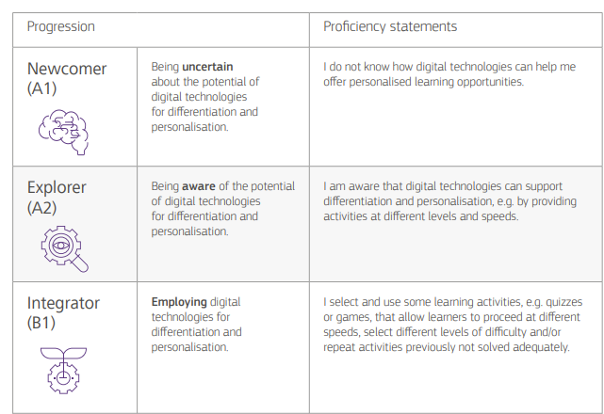
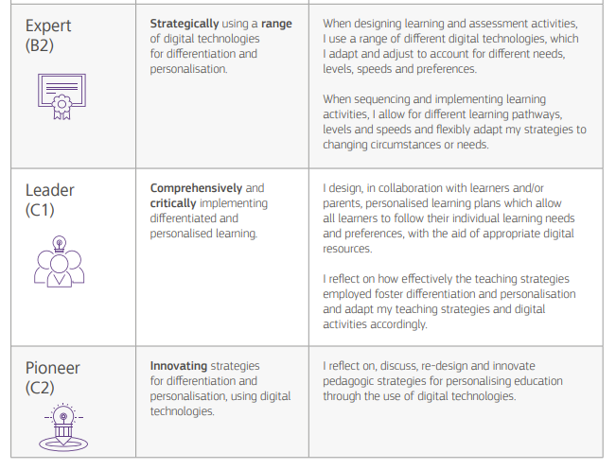
DigCompEdu - Differentiation and personalisation progression and proficiency
Source

Slide 38
UNIT 4 EMPATHY SKILLS
In these times, more than ever, empathy is an important skill which can help individuals work towards better inclusion.
Empathy is the ability to see the world through another’s perspective and it is a vital skill for differentiated learning in an inclusive classroom.

Slide 39
WHY IS EMPATHY IMPORTANT?
As educators, we have a great understanding of the bullying and violence problems plaguing students in school today.
There is no single solution to these problems, but if we begin to engage students in empathy in the classroom, perhaps we can promote understanding, sensitivity, and awareness of those around us so that students may carry these skills into the world around them.
Source

Slide 40
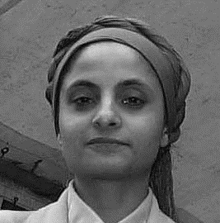
Inclusive Educator Insight
“Understanding each individual learner’s cultural background, hobbies, learning style is the first step in ensuring we are inclusive in our delivery.”
Yasmin Akhtar
Go-Woman! Alliance CIC

Slide 41
RESOURCE SPOTLIGHT - EMPATHY MAP CANVAS
Pulling together information about a student into what’s known as an empathy map can help teachers provide better instruction.
In education, an empathy map is a simple visual that captures knowledge about the behaviors, attitudes, needs, strengths, struggles, emotional states, and other key attributes of a particular student or group of students.
Activity – in the resources section will find a copy of this Empathy Map. Fill in an empathy map for each or as many students as possible in your class. Use the findings to guide your instructional decisions and as a basis of support for your learners
Source 1 Source 2

Slide 42
Three ways to bring empathy in to your classroom
Get to know your classmates activity
Random Acts of Kindness project
Get involved with a charity
An activity like this should encourage students to explore their similarities. Often empathy breaks down because students do not see how much they are alike. Have students get to know each other! This can be done in a low-risk way by:
Interviewing a classmate that you don’t know well
Partner with someone you don’t know
Have students show a random act of kindness for another person – a classmate, or someone else in the school.
Use the reflective journal to have students reflect on how it made them feel to show, and how they feel their kindness impacted others. Simple but very effective!
Invite representatives from a charity to come to your classroom and explain what they do. Ask what your students can do to help the cause and organize a volunteer day.
Getting students involved in charity work is a great way to build empathy–especially considering what’s going on in the world today.

Slide 43
UNIT 5 DIFFERENCIATED ASSESSMENT SKILLS
Assessment skills are crucial in each and every classroom. While it is important to use classroom assessment results to monitor progress for your students, it is equally important to use the results to evaluate your own instructional practices so that you can continue to improve. In the context of INACT, we are now going to explore Differentiated Assessment Skills.

Slide 44
WHY ARE ASSESSMENT AND EVALUATION SKILLS IMPORTANT?
Differentiated assessment is the way by which teachers modify and match assessment with the varied characteristics/profiles of students in order to meet the students’ individual needs, thereby enhancing their learning and boosting their ability to show what they have learned.
Students differ in their previous learning experiences, readiness, learning styles, preferences, academic standing, abilities, strengths and weaknesses, culture, race, and backgrounds. Teachers use differentiated assessment to match and respond to the varying learning needs of diverse students in a classroom.

Slide 45
Formative Assessment
not for marks, but rather to help give the teacher a better idea on how to help the students move froward
teacher performs assessment before the learning takes place
ensures that the teacher plans the lesson to best meet the needs of the students
usually for setting goals
Ex. peer assessment, exit slips
Source

Slide 46
Formative Assessment Strategies to try in your Differentiated Classroom
Ponder and Pass
Signal and Action Response
QuickWrite
​On a chart, have the students write the facts they know on the given topic, information they want to learn, and questions they want to explore
The paper is the passed around the room to each student
After a lesson, have the students perform an action which indicates their level of understanding
For example:
Waving hands= I know it
Shrug of shoulders= I have a hunch
Thumbs down=I have no idea
Brief, timed writing activity
Students have 2 or 3 minutes to reflect on and summarize what they have learned
Give students a sticky note during a lesson, advise them that they will have time to reflect on what they have just learned
Source

Slide 47
Summative Assessment
takes place after the student learning occurs
used to see whether students have achieved initial goals
typically used for marks
it provides an end and final result
evaluate student learning at the end of a lesson or unit
Ex. midterm exam, final exam, final project, a paper
Source

Slide 48
Summative Assessment Strategies to try in your Differentiated Classroom
Different Ways of Testing
Options for Projects that are Evaluated Summatively
On a test, a teacher may allow students to chose how they want to show their understanding of a certain concept
For example, when asked about the water cycle, students may have the option to draw the process, label appropriate transitions and phases, or writing a descriptions
Gradually expand the kinds of assessment choices offered to students - Oral vs. Written, Practical etc.
Give students the options to complete assignments in different ways
Ex. comic strip, story, presentation, video, poster, website
Can have a different rubric for each form, but still the same final goal
Individual & Group Assignments
Source

Slide 49
UNIT 6 TEACHING STUDENTS TO APPLY THE CONCEPT
One of the best ways we can ensure student apply concepts and their learning is by encouraging and facilitating active learning.
Active learning is an important component of inclusive teaching because it promotes multiple modes of engagement to reach all students.
Source

Slide 50
What does active learning look like?
Students are involved in more than listening.
Instruction emphasizes the development of students’ skill rather than just transmitting information.
Students develop higher-order thinking skills (analysis, synthesis, evaluation).
Students are engaged in activities (e.g., reading, discussing, writing).
Students explore their own attitudes and values.
Source

Slide 51
Let’s explore…
This Learning Pyramid illustrates the percentage of learner recall that is associated with various approaches.
The first four levels lecture, reading, audiovisual and demonstration are the passive learning methods.
In contrast, the bottom three levels discussion group, practice by doing and teach others are participatory/active learning methods.
Source

Slide 52
Inclusive Educator Insight
“We focus a lot of reflection as a way to engage learners in their own learning practice - considering what a given project/task meant to them, what insights they gained from it, etc. while encouraging them to think about ‘next steps’ - how they might apply their learning going forwards. For me, it is important to acknowledge that in a class of say, 30 students, you will have 30 different ‘student journeys’ and it is important to actively work with students to help them figure out - and embrace - their own unique journey.”
Eileen Diskin, UCD Innovation Academy

Slide 53
Tips and insights on introducing active learning in your classroom
Using active learning techniques in your teaching requires only a willingness to try something new in the classroom, gather feedback, and plan an activity that furthers your course learning goals.
With any use of active learning, it is important that the activity be more than “busy work” or a “break from lecture.”
Rather, the approach should be intentionally selected to allow students to practice a key idea or skill with peer or instructor feedback.
Instructional approaches that promote student interaction are most likely to enhance student learning in a diverse classroom and active learning can be a powerful way to promote that exchange.
Source

Slide 54
Inclusive Educator Insight
“I recently introduced 'Greenhouse Project Time’. A Greenhouse project time gives students the opportunity to explore and grow a project - in an active, hands-on way - within an area of personal interest…as long as it in some way relates to the overall subject area of the course (sustainability). Essentially a ‘passion project’ or a ‘pet project’. This is timetabled for 4 hours each week - from learning about wildlife & making watercolour paintings, planting a rooftop garden, up cycling, creation of a community greenspace etc., curation of sustainability-themed Instagram pages, each project came from the individual students own area of interest..”
Eileen Diskin, UCD Innovation Academy

Slide 55
ACTIVITY: 8 Active Learning Strategies and Techniques for you to introduce to your classroom
Reciprocal questioning: ​Create an open dialogue in which students take on the role of the teacher and generate their own questions about a topic, reading section, or lesson.
Three step interviews: ​Encourage students to develop active listening skills by quizzing one another, sharing their thoughts, and taking notes.
The pause procedure: ​Intersperse strategic pauses into your class lectures to enhance students' understanding of teaching materials.
The muddiest point: ​Ask students to write notes on the most unclear or most confusing element of a given homework assignment, lecture, or class discussion.
Source

Slide 56
8 Active Learning Strategies and Techniques
Peer teaching activities: ​Deploy a range of strategies that have students instruct skills or explain concepts to classmates.
Game-based learning platforms: ​Use specialized games to add depth and differentiation to the educational process, helping students to achieve their learning objectives. Be sure that the technology you choose is accessible and suits your learner digital skills levels
Rotating chair group discussions​: ​Encourage students to actively listen to selected speakers who follow a pattern of guiding class discussion and summarizing previous point
Source

Slide 57
Synopsis
In this module, you have learned about some of what we deem to be the top teacher skills for differentiated instruction.
You have gained insights from other educators on the importance of some of these skills and via the activities you have had the opportunity to delve deeper and/or reflect on your own skills levels.
As well as exploring skills, we have given you some strategies and insights on how to put these skills to use and work in your differentiated, inclusive classroom.

Slide 58
www.inclusiveeducators.eu
This in the final module in our course. For more learning opportunities,
we invite you to explore and engage with us on

